Slide 1
Cryptography Unplugged

Slide 2
How would you send secret information to someone else?

Slide 3
Transposition
Substitution
Obfuscation (Steganography)

Slide 4

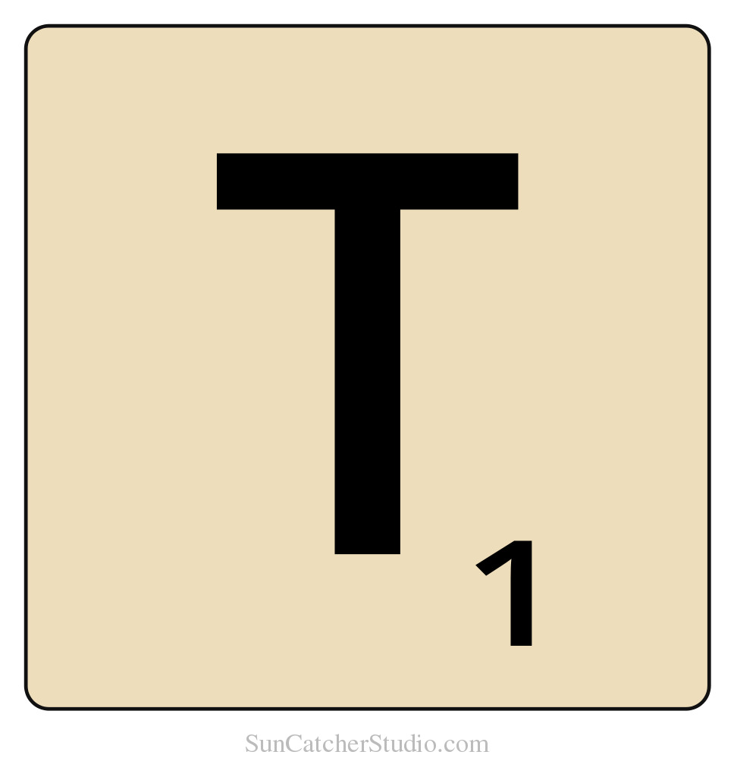
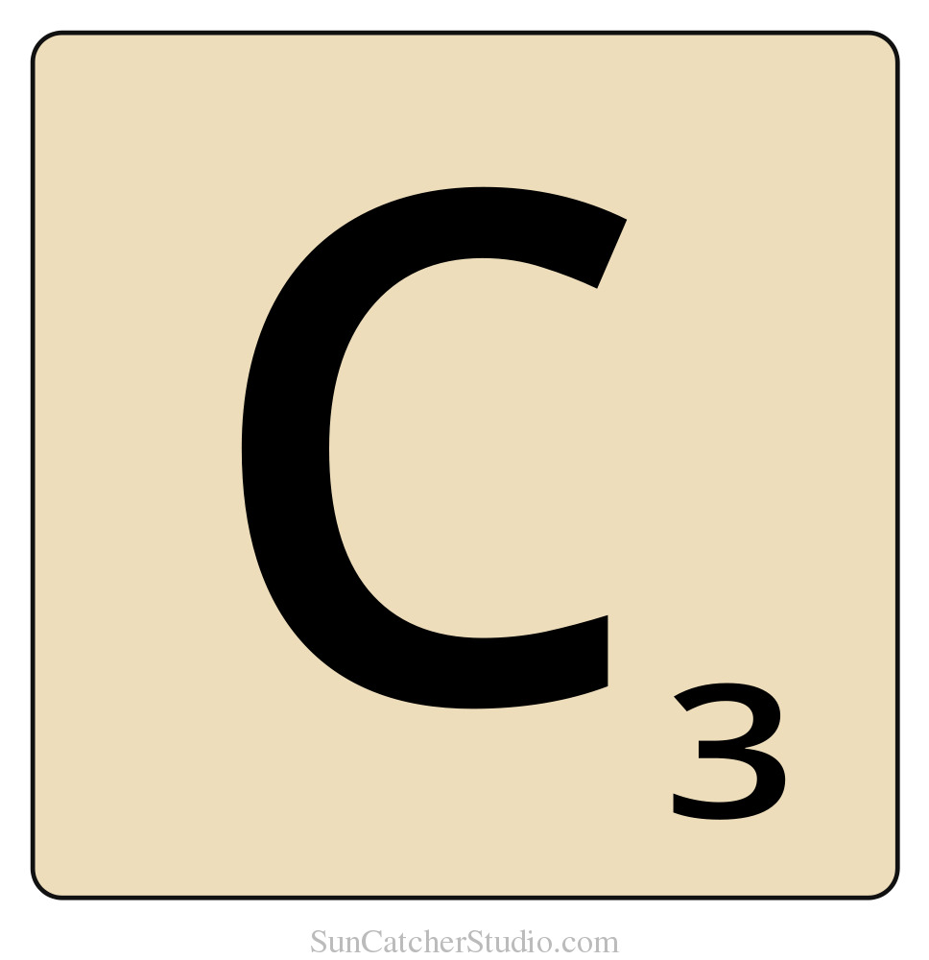

Sample Message

Slide 5
Transposition

Slide 6
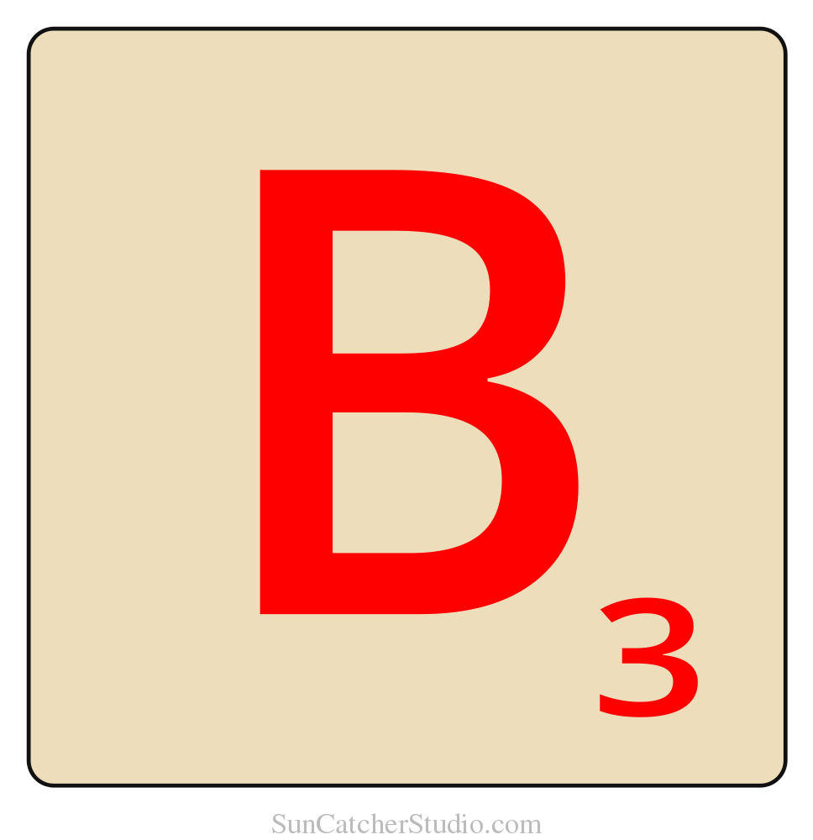

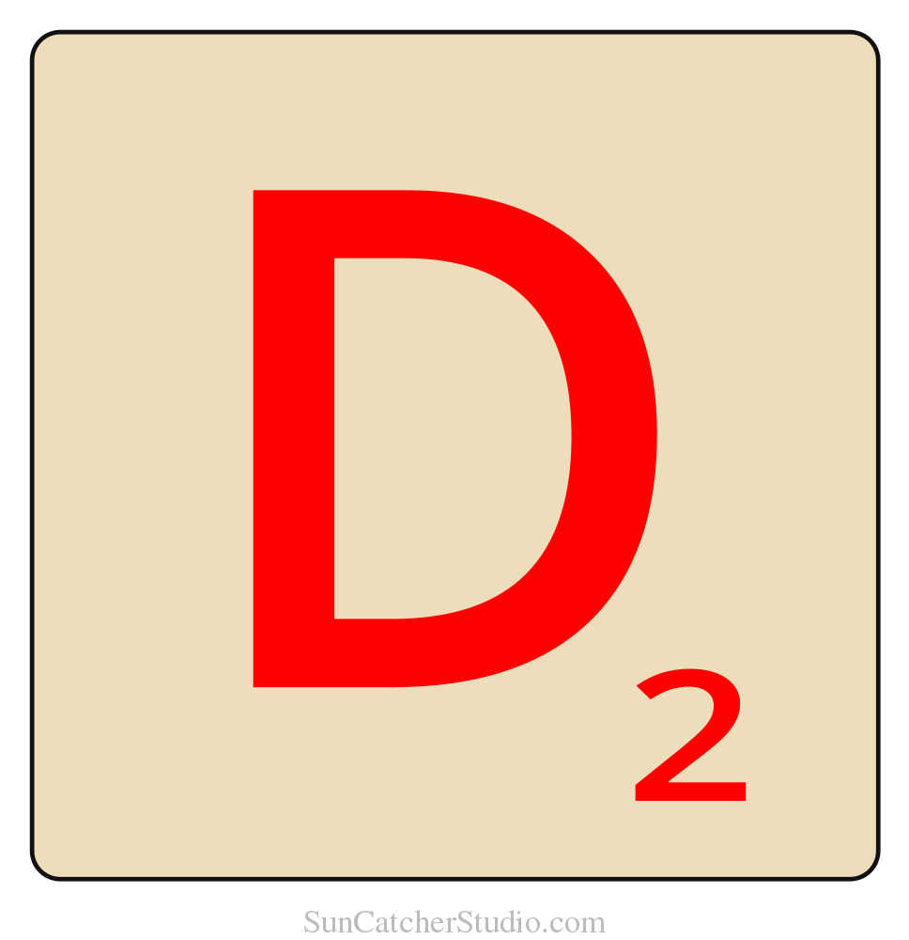
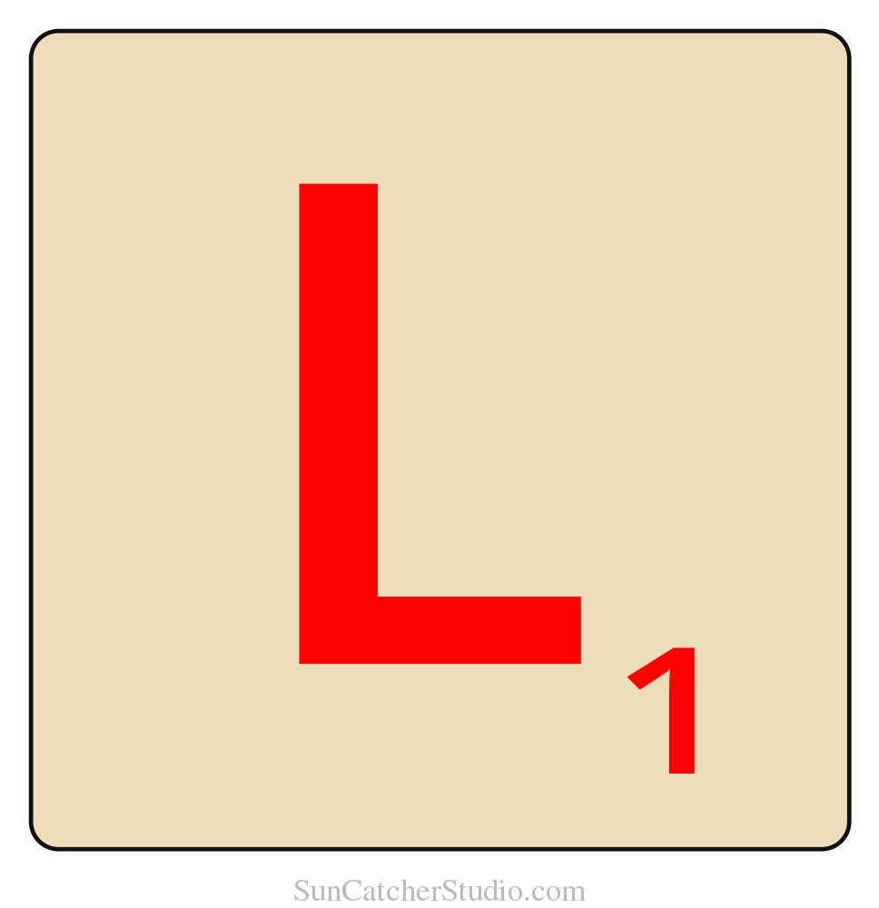
Substitution

Slide 7
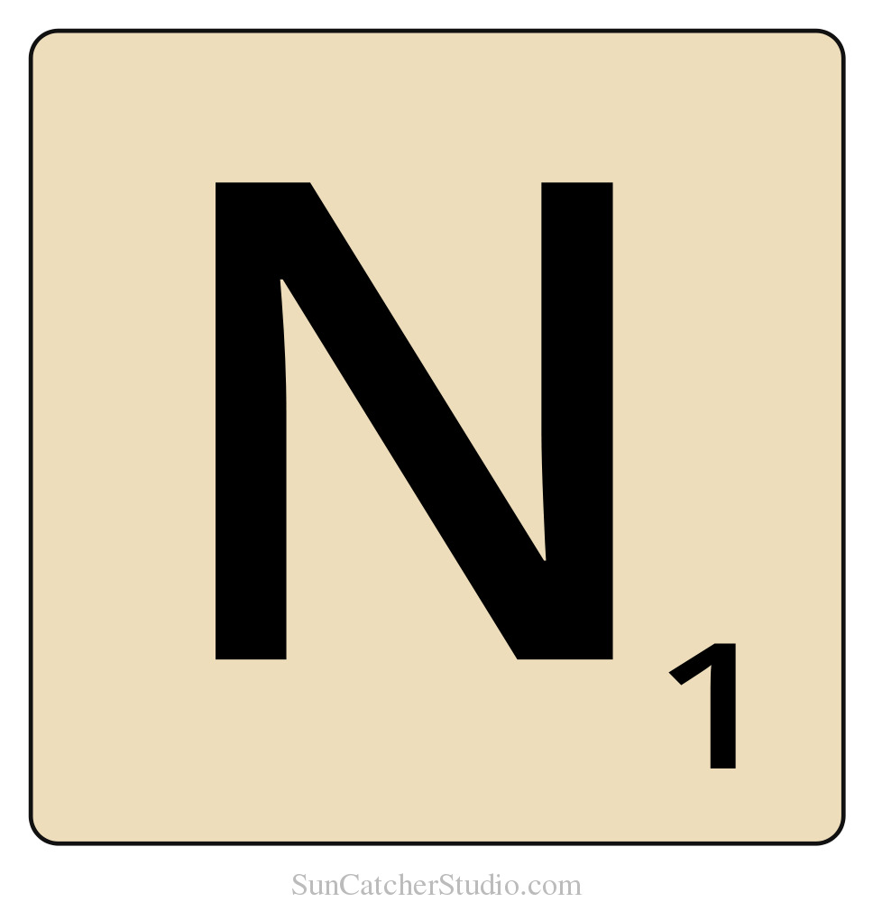

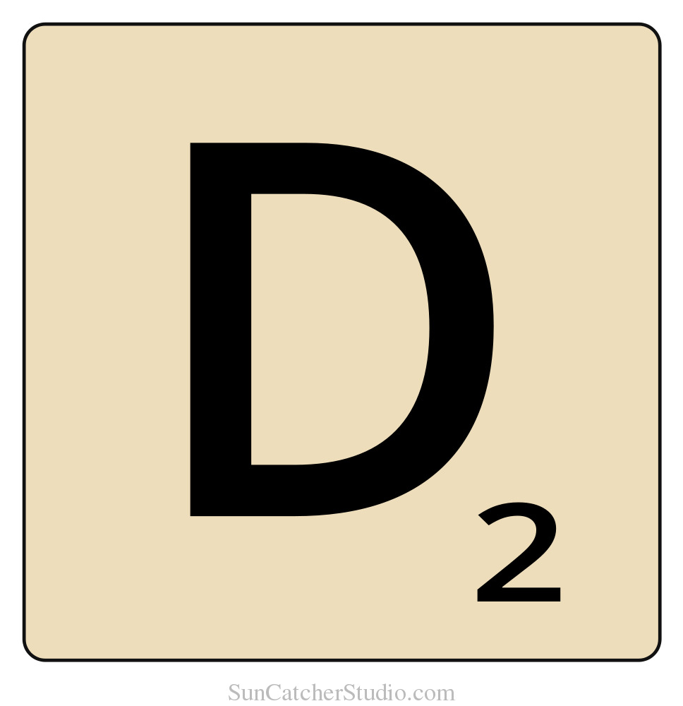

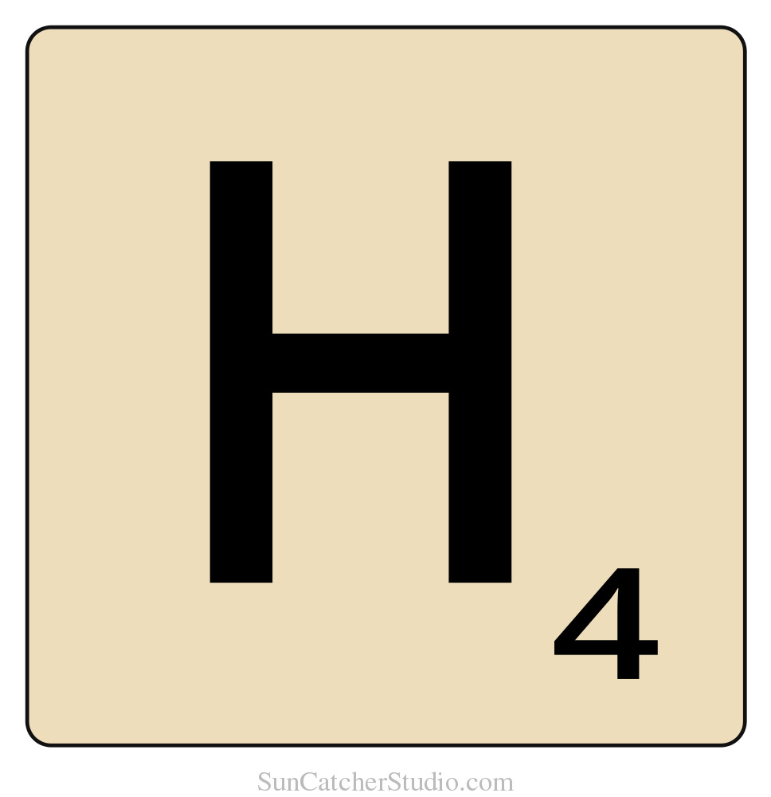
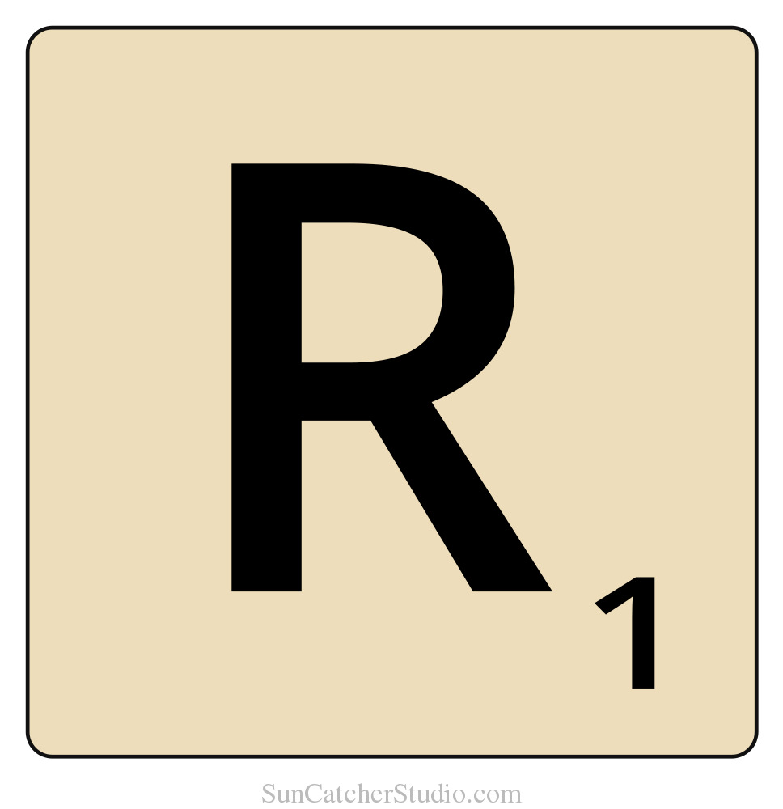
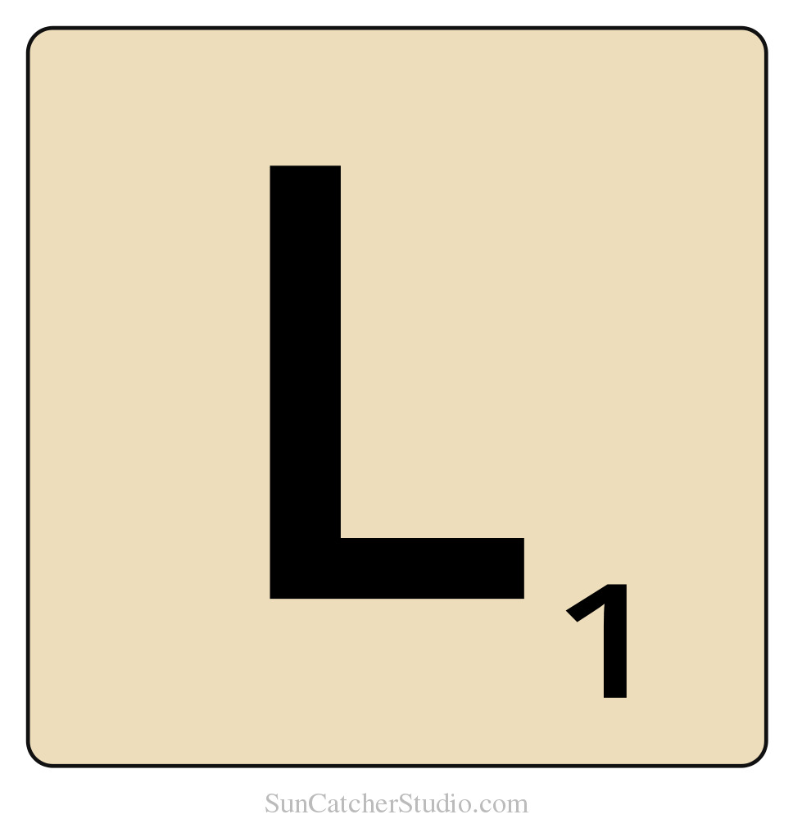
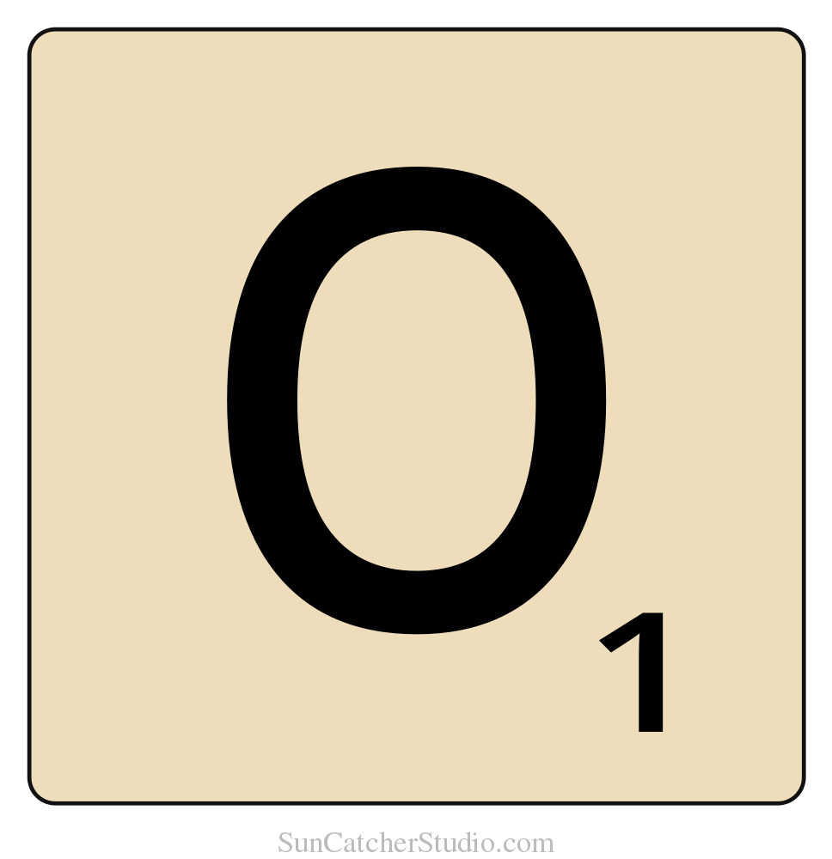
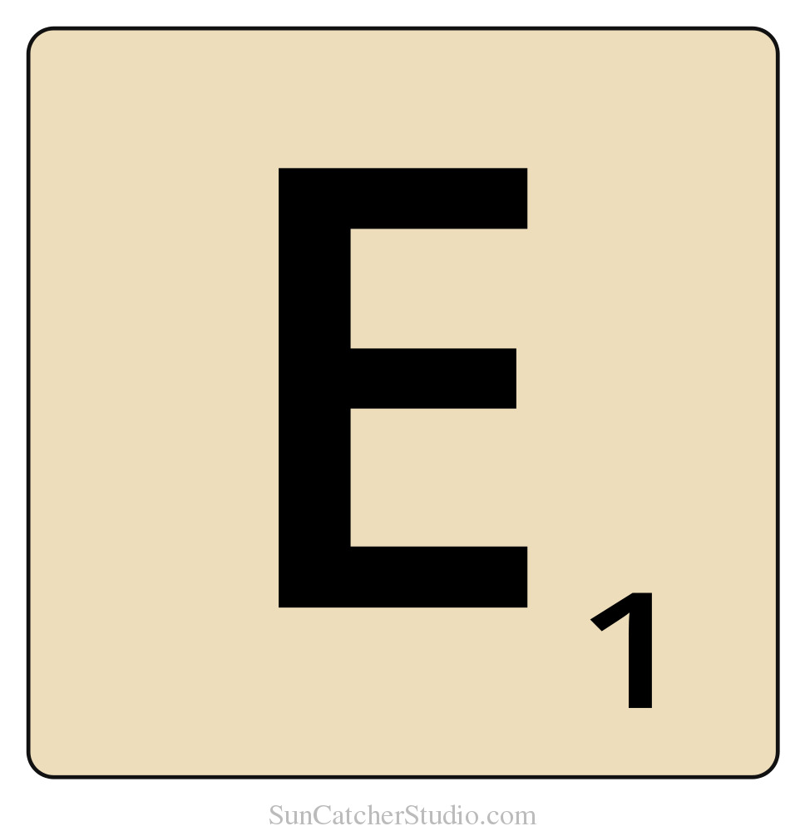
Obfuscation

Slide 8
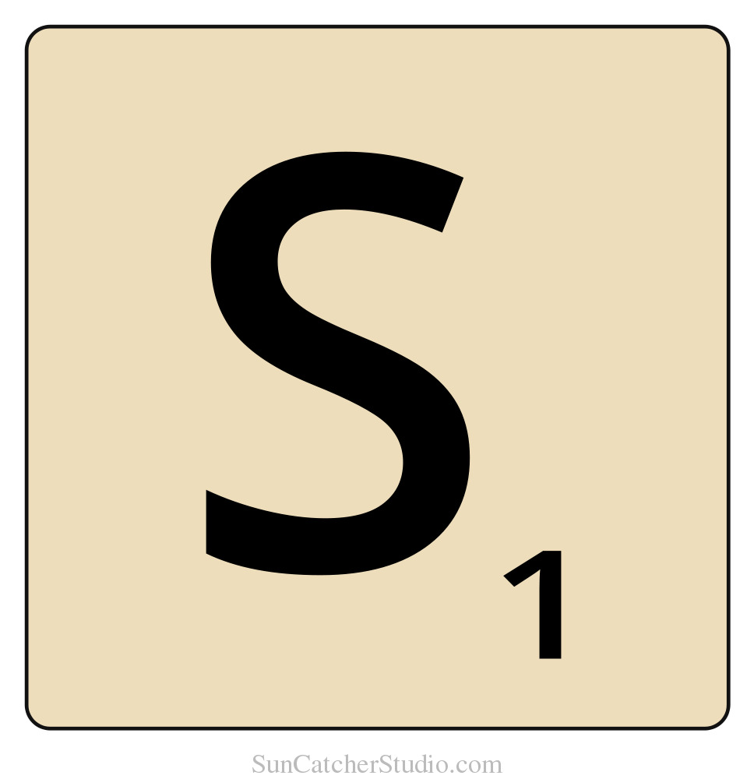
Obfuscation
Notes:
Recovery is difficult

Slide 9
Terms
Plain text
Plain text
Key
Encryption/Decryption
Cipher text Encrypt
Key
Encrypt
Cipher text

Slide 10
Elizabeth it is in vain you say
'Love not' — thou sayest it in so sweet a way:
In vain those words from thee or L. E. L.
Zantippe's talents had enforced so well:
Ah! if that language from thy heart arise,
Breathe it less gently forth — and veil thine eyes.
Endymion, recollect, when Luna tried
To cure his love — was cured of all beside —
His folly — pride — and passion — for he died.
Edgar Allen Poe

Slide 11
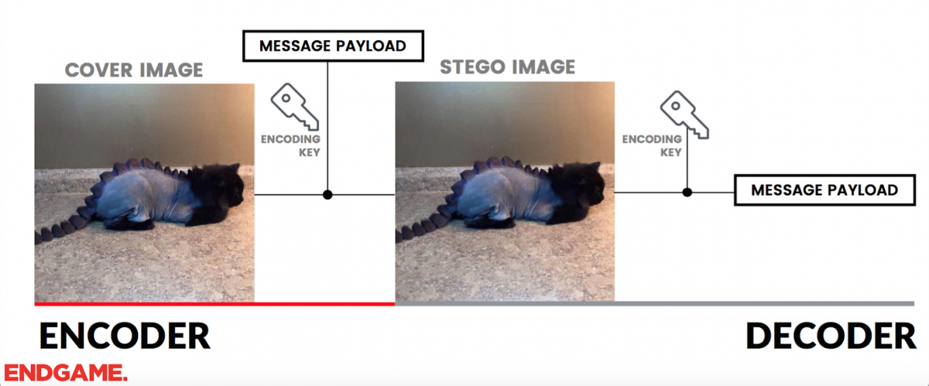

Slide 12
Breaking Encryption
Frequency Analysis
Known text
Brute Force

Slide 13
Transposition French Rail Cipher
Encryption: Fill a grid horizontally and read out letters vertically
Decryption: Fill a grid vertically and read out letters horizontally
Key: The number of columns to use.
THIS IS NOT A SECRET MESSAGE
Key: 5

Slide 14
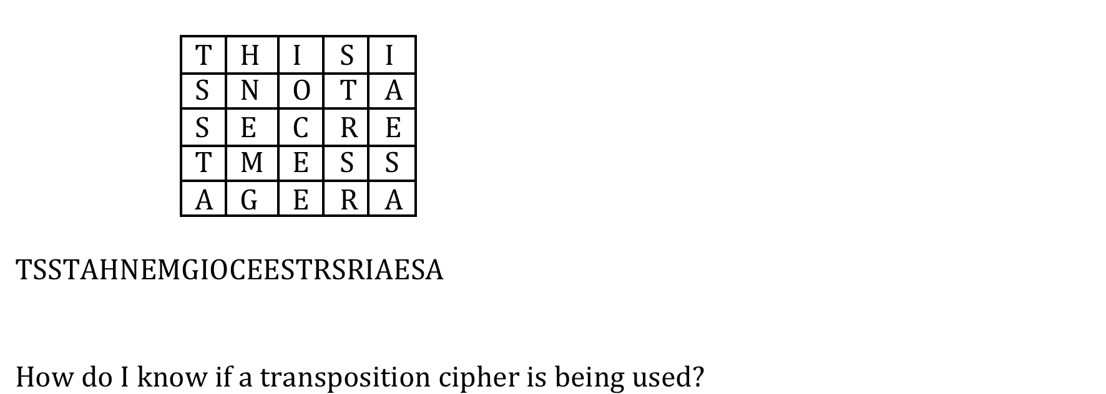
TRansposition

Slide 15
Frequency
ETAOIN SHRDLU (type setting)
ETAOIN SRHLDC (English text)

Slide 16
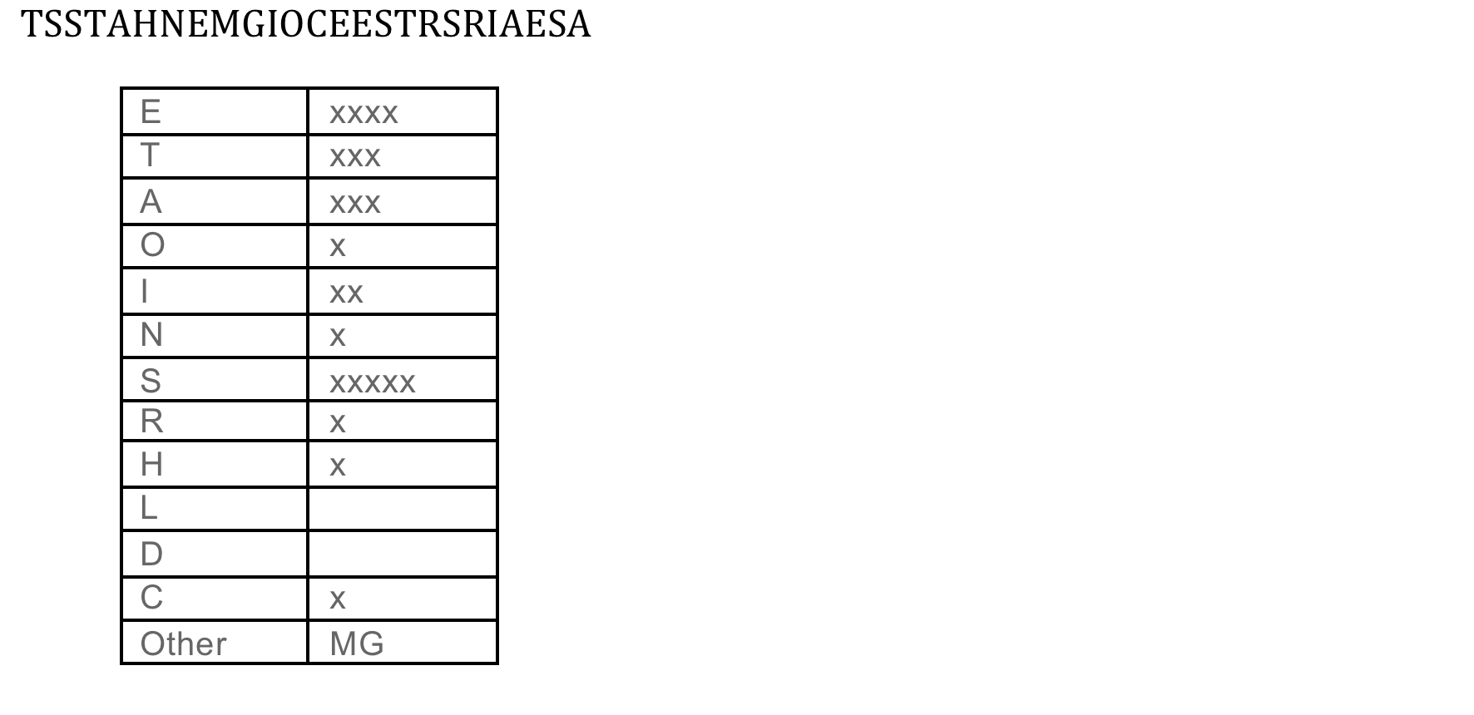

Slide 17
Frequency
First, Second, Third, Last letters of words.
Digraphs/Trigraphs
Double Letters
See handout!

Slide 18
Substitution CAESER Cipher
Encryption: Shift each letter forward by a given amount
Decryption: Shift each letter backward by a given amount
Key: The shift.
THIS IS NOT A SECRET MESSAGE
Key: Shift 1
UIJT JT OPU B TFDSFU NFTTBHF

Slide 19
Breaking Substitution
Find the frequency of each letter.
Make guesses for the high frequency letters.
Guess words/digraphs/trigraphs
Guess vowels
Guess words from context
See handout for example!
If I know both the plain text/cipher text I can determine the key

Slide 20
Substitution Vigenere
Encryption: Table lookup
Decryption: Reverse Table lookup
Key: A phrase (repeated if needed)
Each letter is shifted by a different amount that depends on the key.
How would you break it?

Slide 21
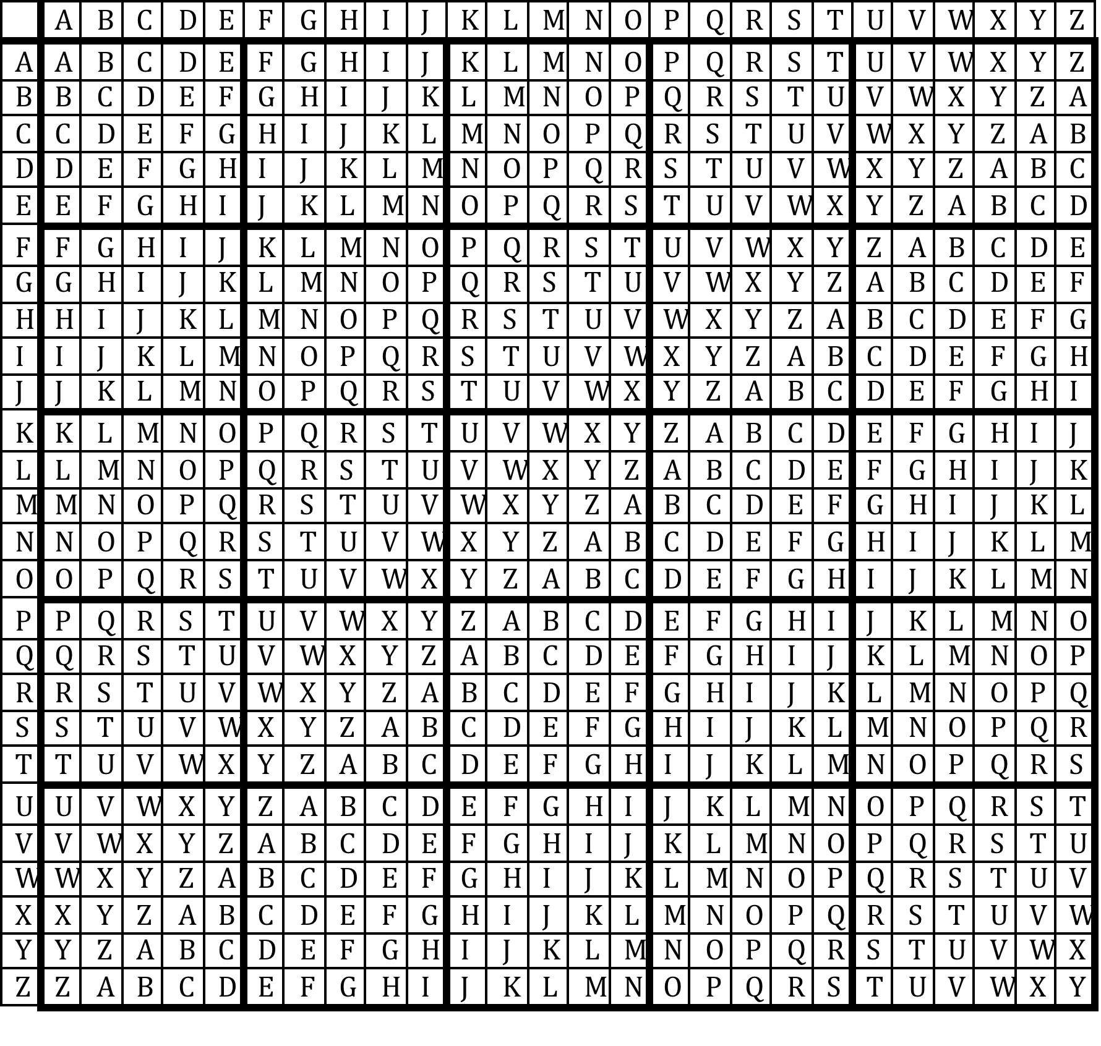

Slide 22
Key: NAPOLEON

Slide 25
Breaking Vigenere
Guess the length of the key
Use frequencies to guess key/message values
Longer keys are stronger
Keys that do not have patterns are stronger
Longer messages are weaker
If I know the plain text and cipher, I can find the key.

Slide 26
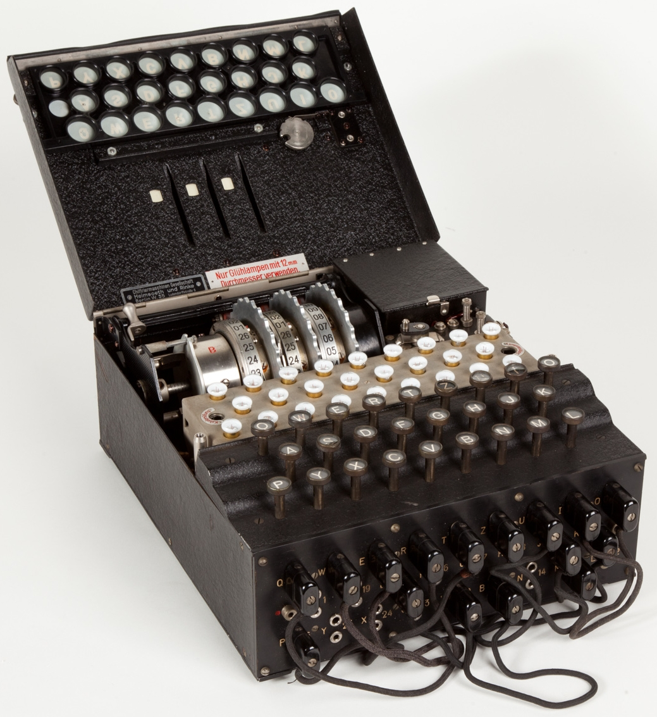
Enigma
Rotors/plug board
Key is Initial setting
Daily change
Key press causes rotation
Poland broke early versions
Germany added Rotors

Slide 27
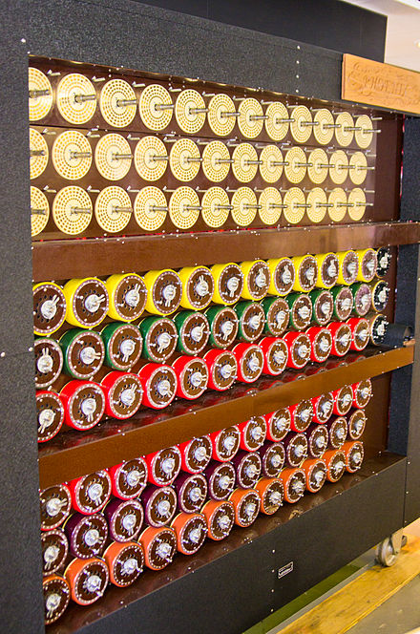
Break Using
By Hand (rotor only)
Brute Force (+ plug board)
Needed a guess of part of plain text (crib)
Or break same message sent less securely
Mechanical/Electrical

Slide 28
Extras
GitHub repository with:
The power point
Frequency analysis sample handout
Substitution encrypted messages to crack
WebApp that automates frequency analysis
https://github.com/Charles-Hoot/CyberPalooza-Crypto-Unplugged
https://charles-hoot.github.io/CyberPalooza-Crypto-Unplugged/freq.html

